Slide 1
Distributed Operating System

Slide 2
Introduction
Distributed Operating System is a type of model where applications are running on multiple computers linked by communications. It is an extension of the network operating system which supports higher levels of communication and integration of the machines on the network.
Distributed OS runs on multiple CPUs but for an end-user, it is just an ordinary centralized operating system. It can share all resources like CPU, disk, network interface, nodes, computers, etc. from one site to another site, and it increases the data available on the entire system.
All processors are connected by valid communication media such as high-speed buses and telephone lines, and in which every processor contains its own local memory along with other local processors.

Slide 3
Introduction
According to this nature, a distributed operating system is known as a loosely coupled system. This operating system involves multiple computers, nodes, and sites, and these components are linked to each other with LAN/WAN lines.
Distributed OS is capable of sharing their computational capacity and I/O files while allowing virtual machine abstraction to users.

Slide 4
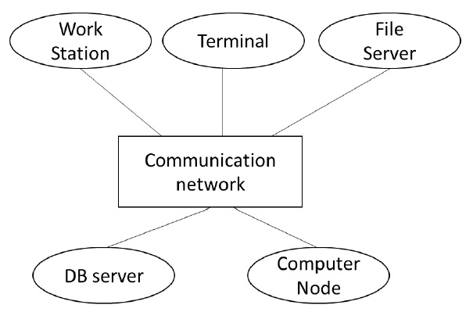

Slide 5
Applications of Distributed OS
The applications of distributed OS are as follows −
Internet Technology
Distributed databases System
Air Traffic Control System
Airline reservation Control systems
Peep-to-peer networks system
Telecommunication networks
Scientific Computing System
Cluster Computing
Grid Computing
Data rendering

Slide 6
Types of Distributed OS
There are three types of Distributed OS.
Client-Server Systems − It is a tightly coupled operating system. It is used for multiprocessors and homogeneous multicomputer. Client-Server Systems works as a centralized server because it provides the approval to all requests, which are generated by the client systems side.
Peer-to-Peer Systems − It is a loosely coupled system. It is implemented in the computer network application because it contains a bunch of processors, and they are not shareable memories or clocks as well. Every processor consists of its own local memory, and these processors communicate with each other through various communication media such as high-speed buses or telephone lines.
Middleware − It allows the interoperability in the between of all applications, which are running on other operating systems. By using these services those applications are capable of transferring all data to each other. It allows distribution transparency.

Slide 7
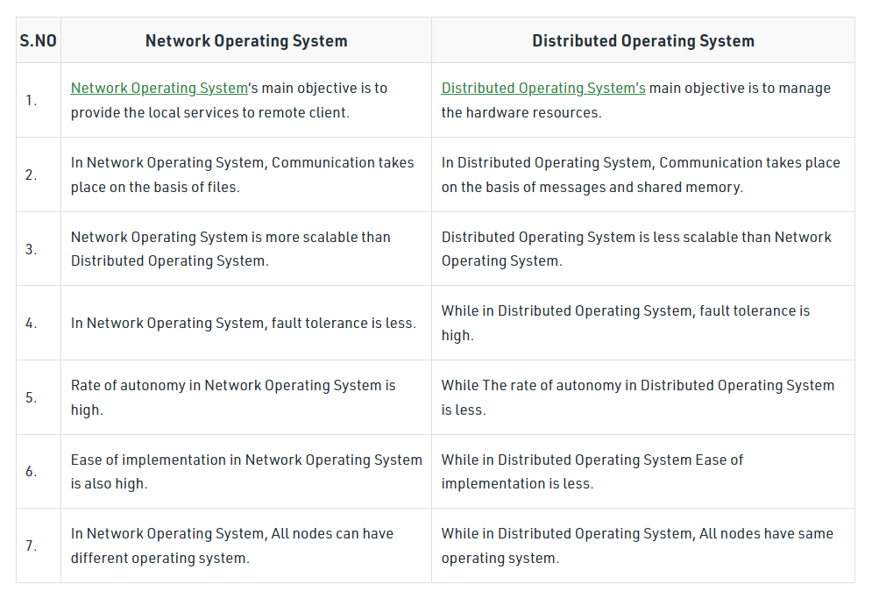
Difference between Distributed and Network OS

